Slide 1
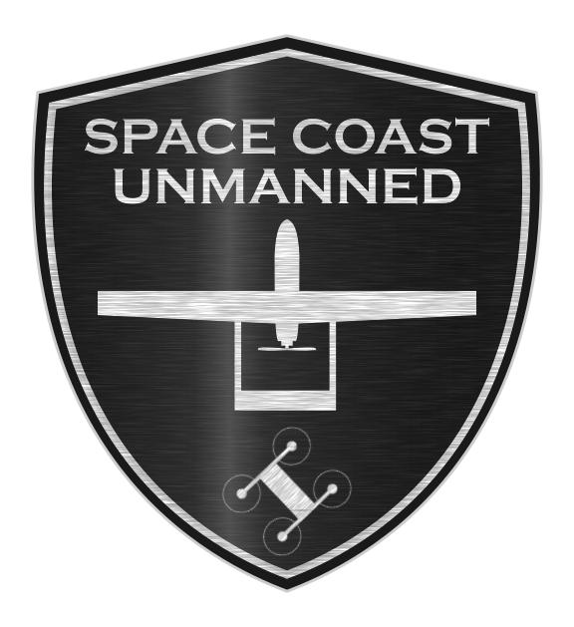
Space Coast Unmanned SPECIAL OPERATIONS SEAT

Slide 2
Objective
Design a light-weight, multi-purpose, forward-facing seat for Maritime Special Operations Forces
Compatible with Combat Rubber Raiding Craft (CRRC), specifically Wing Rigid-Hulled Inflatable Boats (RHIBs)
Quickly reconfigured as a hook/ladder system for obstacle clearance
Seats can be used as a positively buoyant stretcher.

Slide 3
Design Approach
Implement mature open source technologies and reliable commercial off the self products(COTS) where possible to minimize risk
Design and produce as many components as possible to reduce dependencies on outside resources
Reduces risk for future change
Reduces procurement costs
Allows greater customizability to meet customer’s future needs

Slide 4
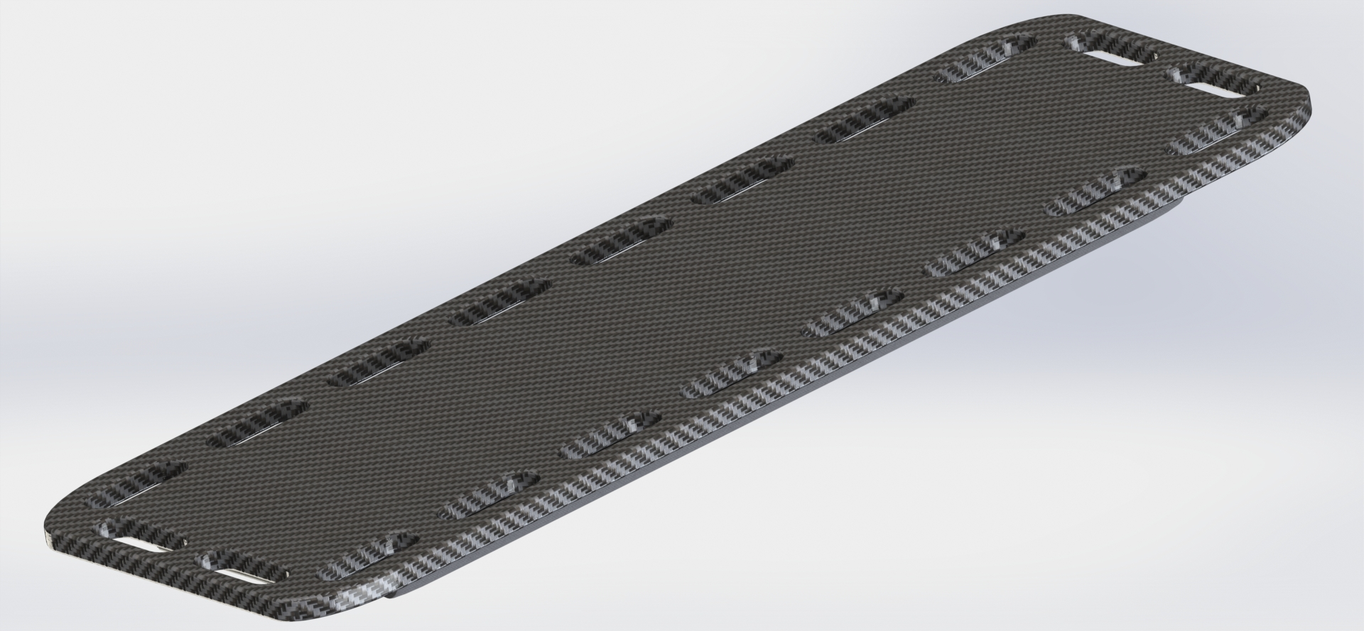
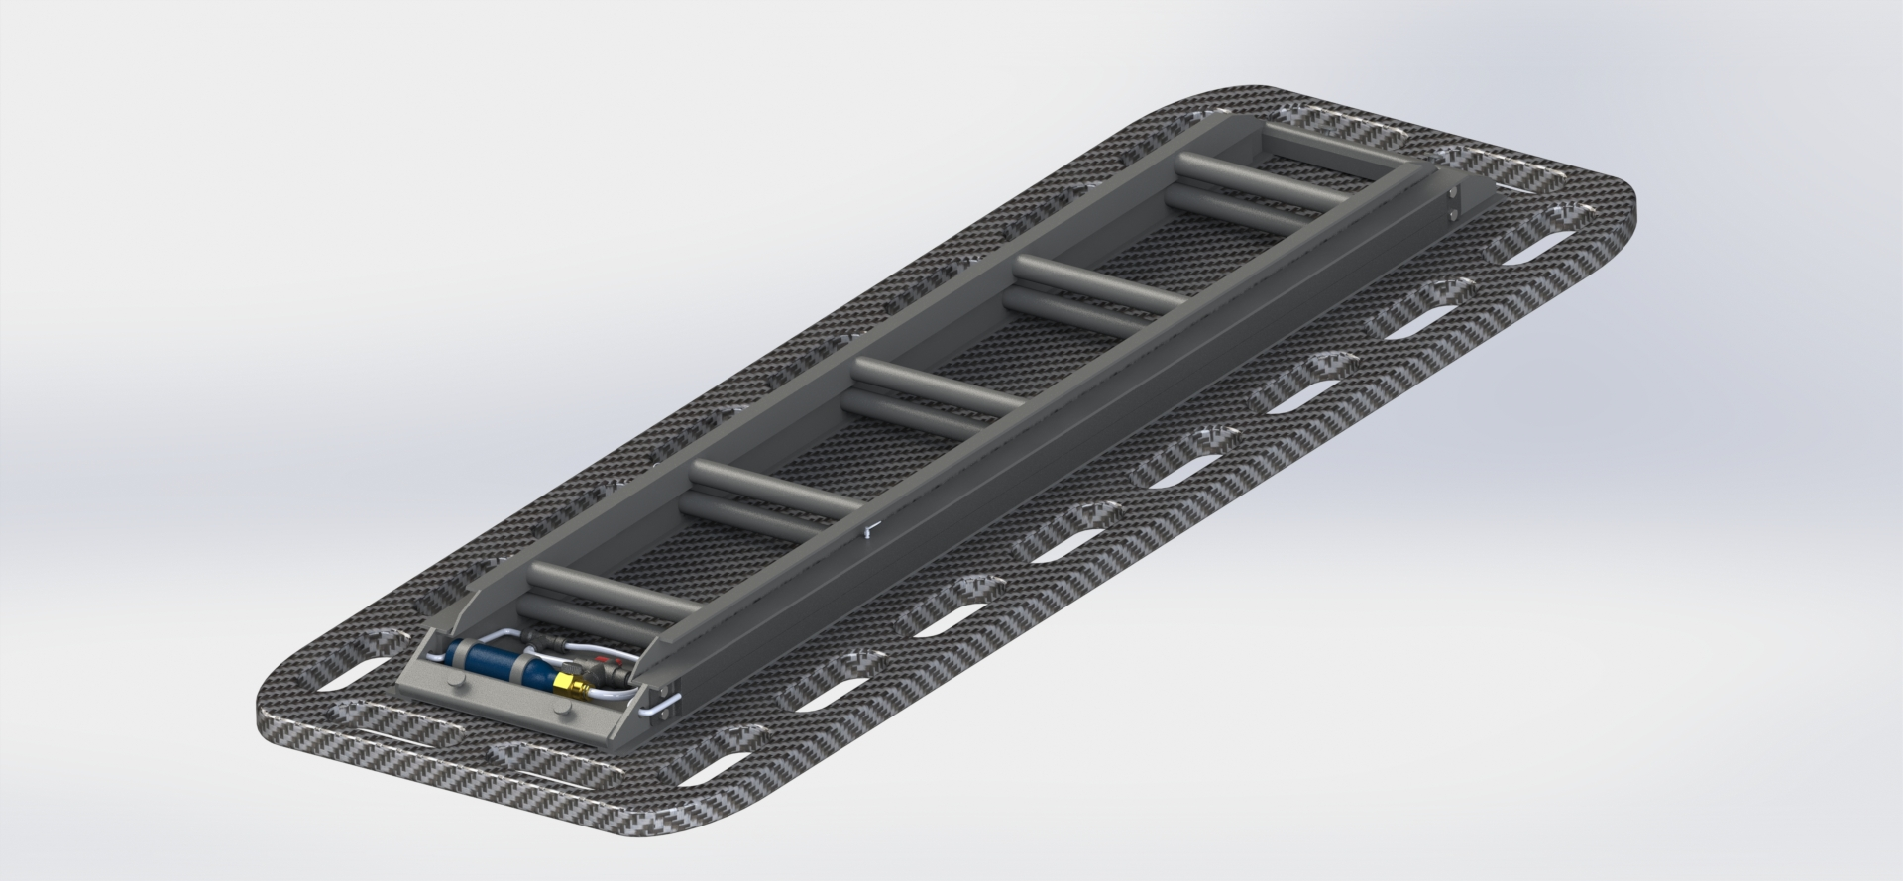
Space Coast Unmanned’s Solution
All in one solution allows a single seat to be used as a stable forward facing seat, ladder or positively buoyant stretcher
Use of COTS ‘L-Track’ to allow for rapid attachment, removal and reconfiguration.
Non skid top surface and grab handles to help with human fatigue in rough conditions.
In current design spec seat weighs ~28.4lbs

Slide 5
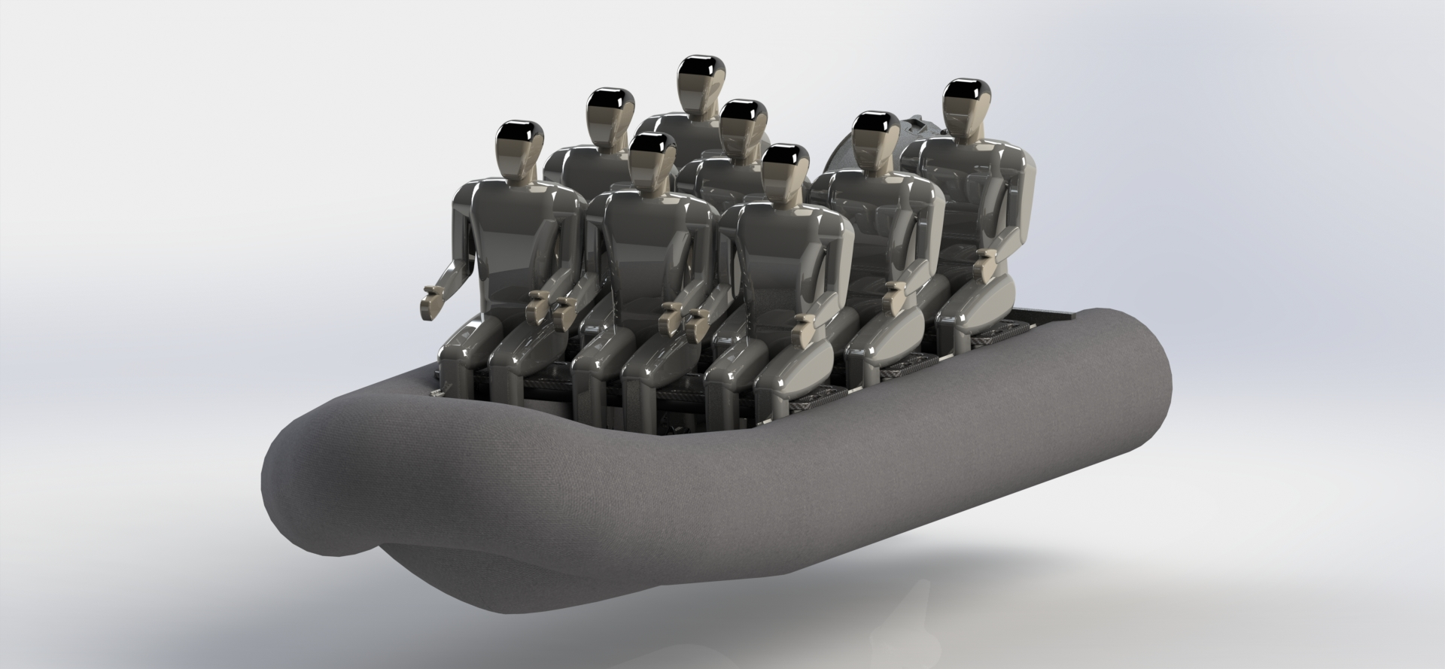
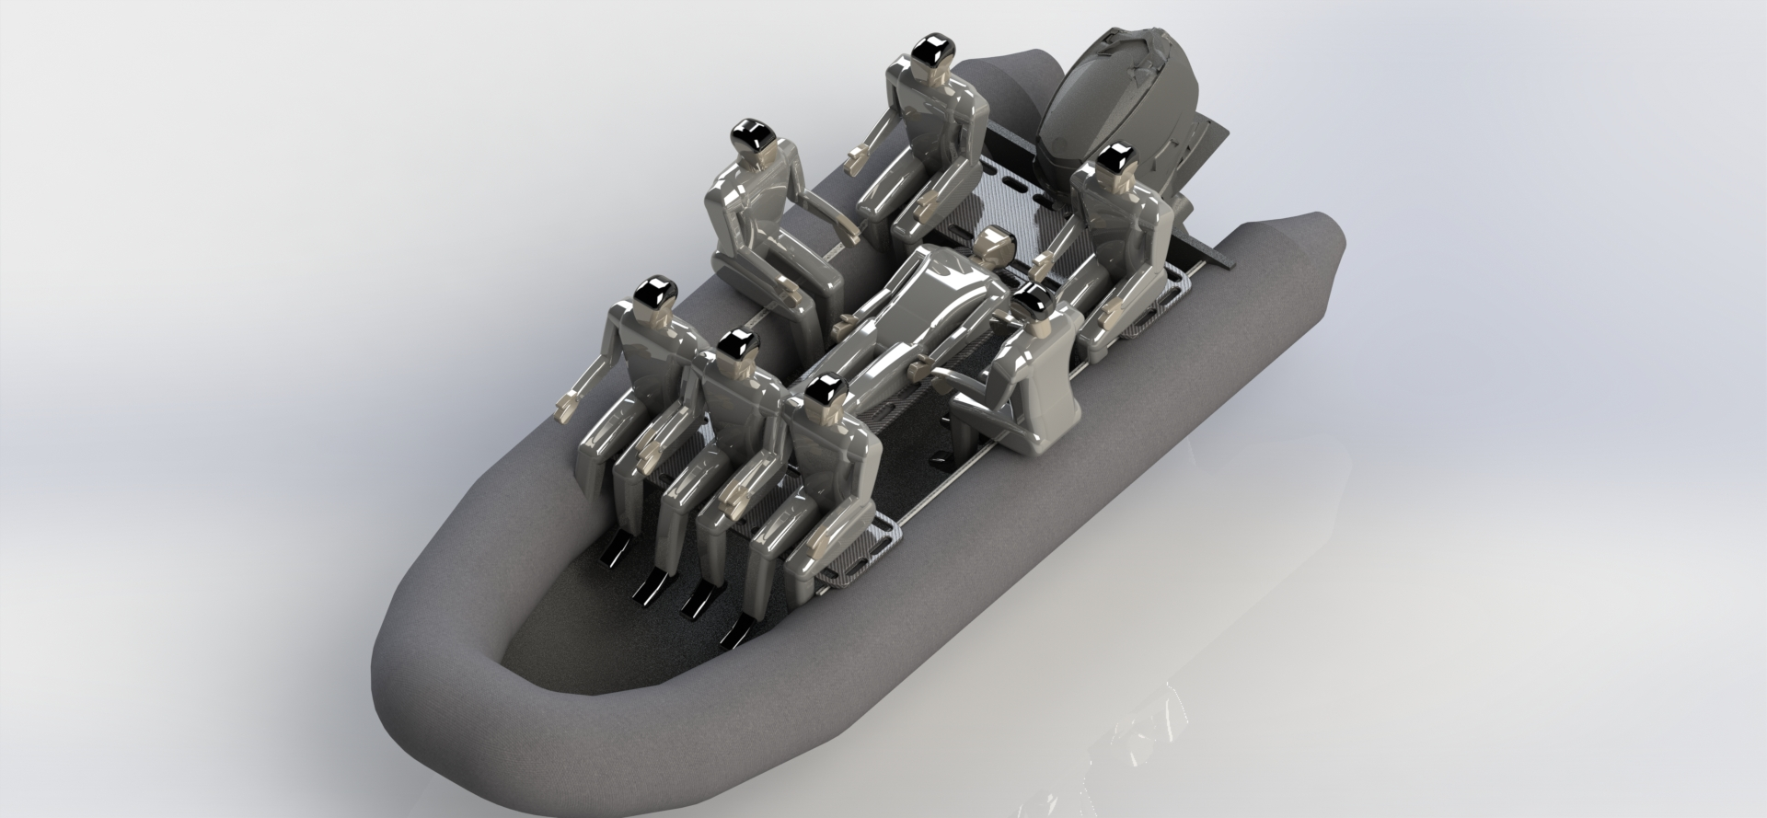
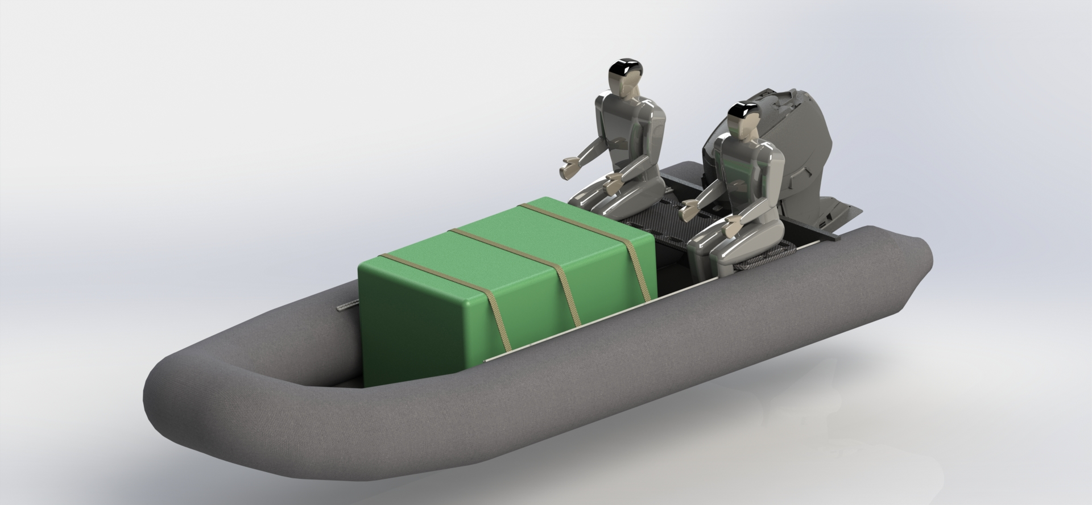
Configurations
Fit up to 8 forward facing crew(all human models are ~6’5”)
Use of seat for boarding ladder
Use of seat as a ladder to climb a quay wall
Inflatable bladder system to ensure positive buoyancy with 400Lb load
Using the seat as a stretcher to safely evacuate a injured person
Use L-Track and COTS tie down rings to strap cargo down in rough conditions.

Slide 6
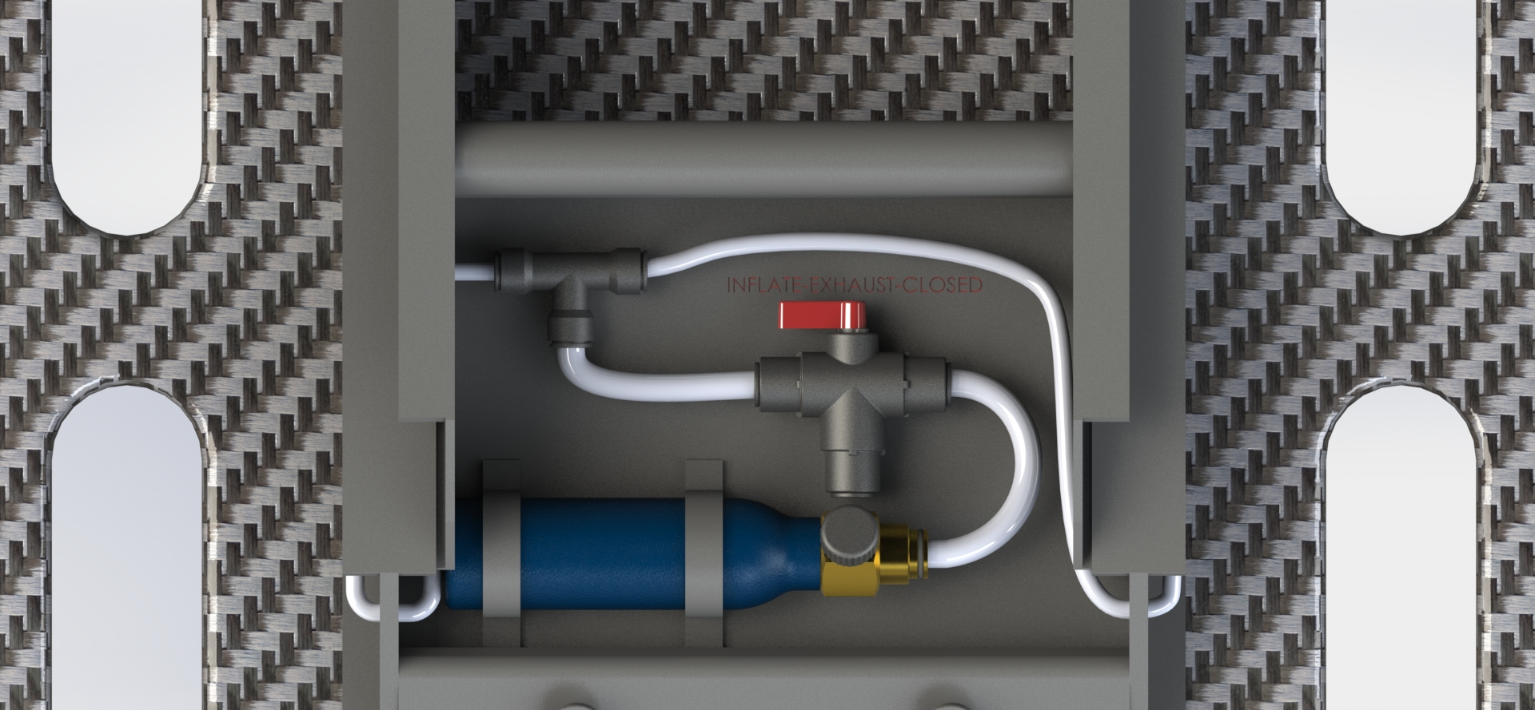
Positively buoyant stretcher
The seat system floats when thrown in water but in order to support a person(400lb) a re-usable co2 powered inflatable bladder system is used
Using a COTS co2 paintball 6oz tank at standard 860psi occupies 9liters of volume at atmospheric pressure. Using co2 allows for easy refill when needed.
9liters is approximately 3 times the volume of the average inflatable life vest.
Two 4.25liter bladders inflate to produce a buoyancy force of ~84 Newton with a 400lb load on the stretcher ensuring positive buoyancy
The bladders can be left inflated when inside the boat, this ensures the operators can quickly remove the injured person and return to safety
CO2 VALVE SYSTEM

Slide 7
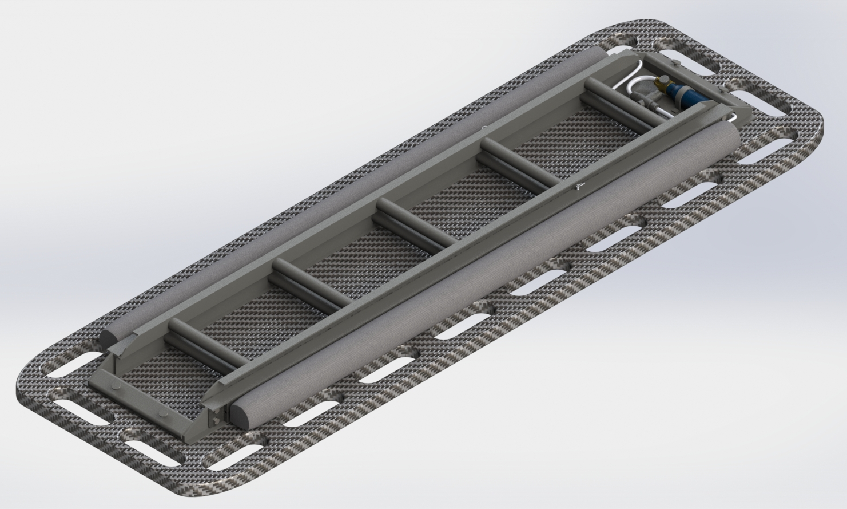
Positively buoyant stretcher Cont.
DEFLATED
INFLATED
CO2 BUOYANCY BLADDERS
CASE (RE-USABLE)
CO2 VALVE SYSTEM
CO2 BUOYANCY BLADDERS(RE-USABLE)

Slide 8
Stretcher design
The seat was designed with multiple grab handles to ensure easy and fast transport of injured person.
GRAB HANDLES

Slide 9
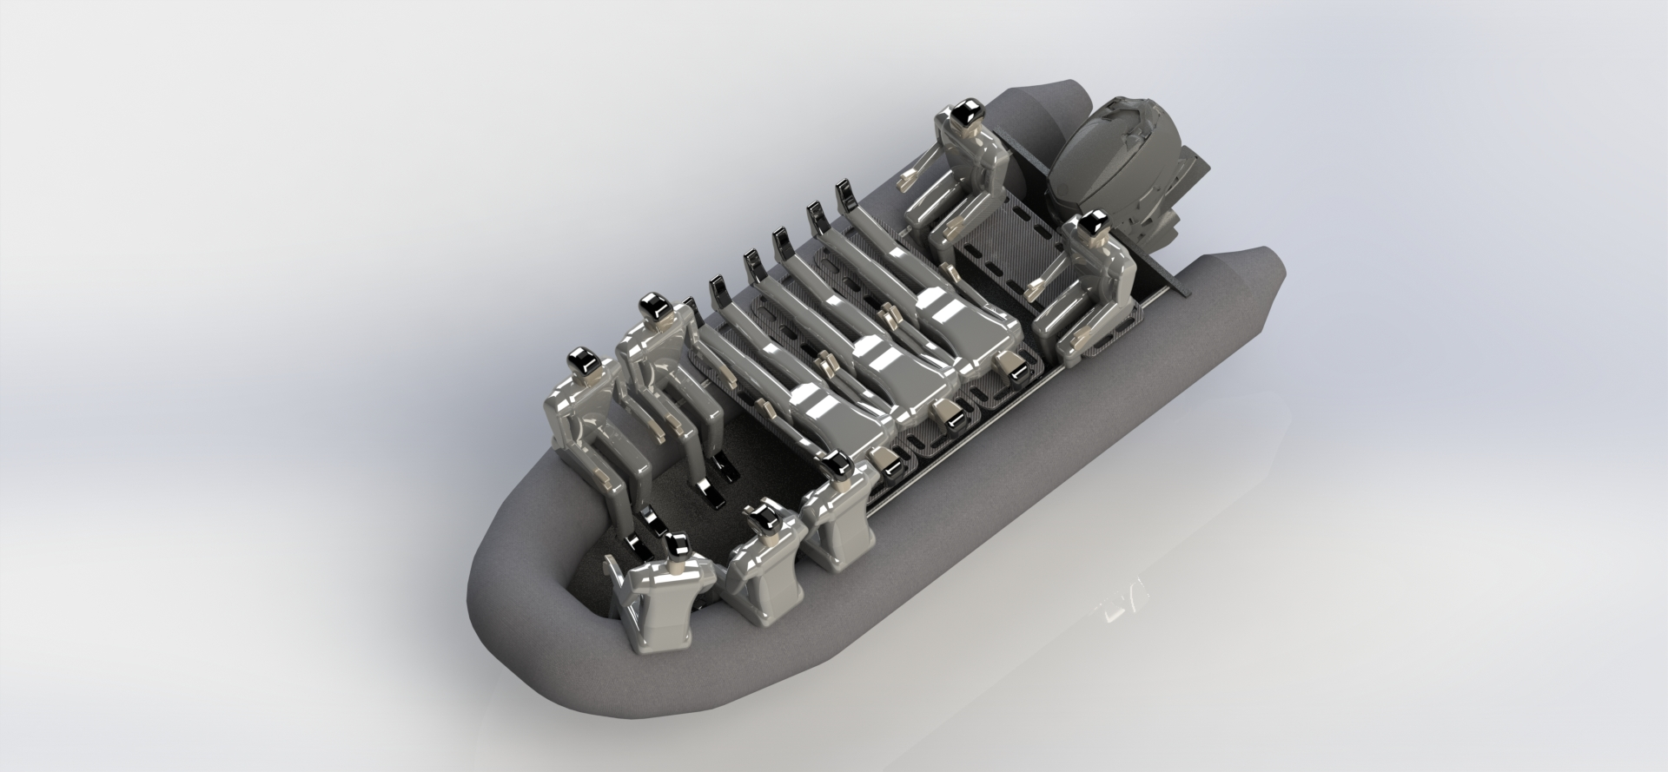
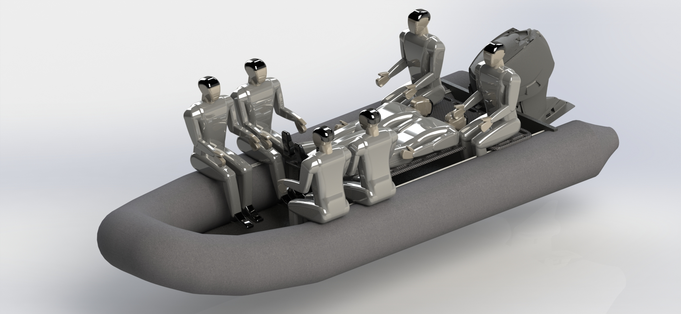
Leave no person behind
With a full crew the seats can be reconfigured to bring home up to 3 injured people on stretchers depending on the seating configuration
Since the seats are attached with L-Track a cross bar can be installed to allow injured people to lay in a more conformable position, minimizing their discomfort.
All human models are ~6’5” Tall ensuring there is enough room for operators no matter there size or equipment load

Slide 10
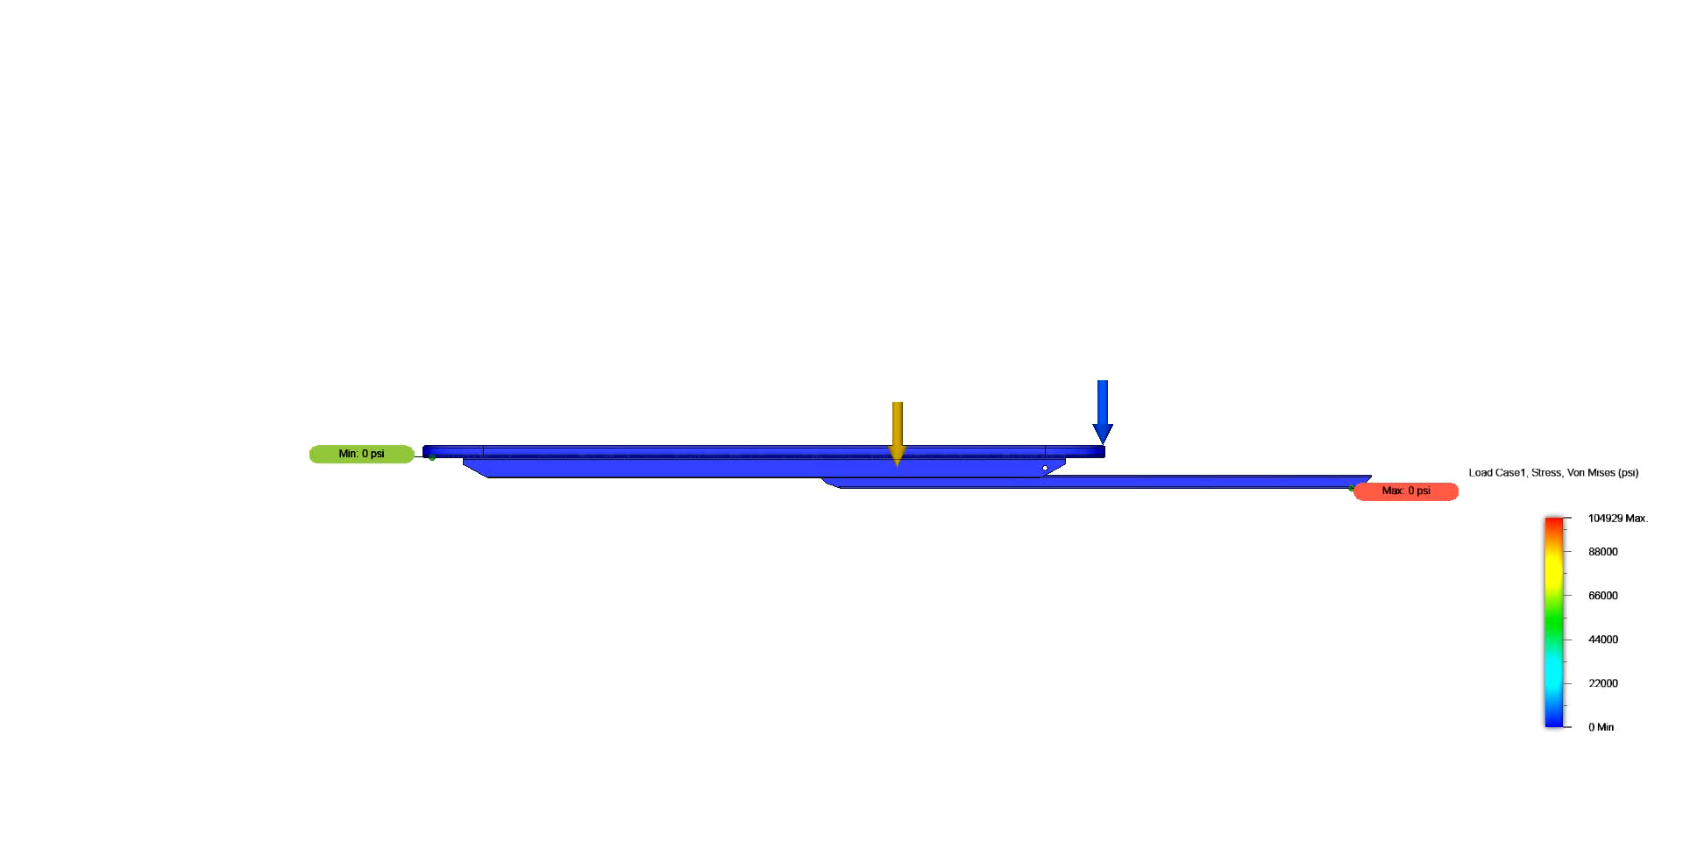
Ladder System
A spring latching extension ladder is located on the bottom of every seat
The seat system was analyzed using Finite element analysis(FEA) simulation software
The results below show a 3g 400lb load with each end fixed. This simulates the use of the extension ladder as a boarding plank. (note: deformation is 10 times real life)

Slide 11
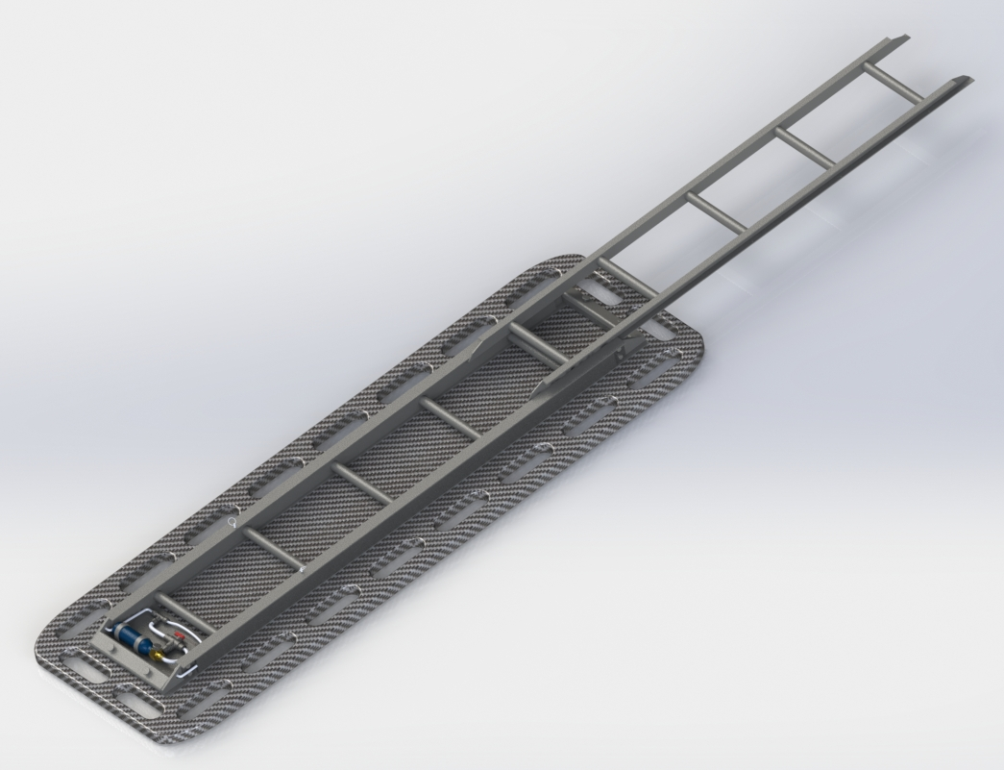
Ladder System Cont.
Ladder extension is easily adjusted in 12” increments up to 10ft total height.
Spring loaded locking pins lock the ladder extension out and allow for rapid extension retract.

Slide 12
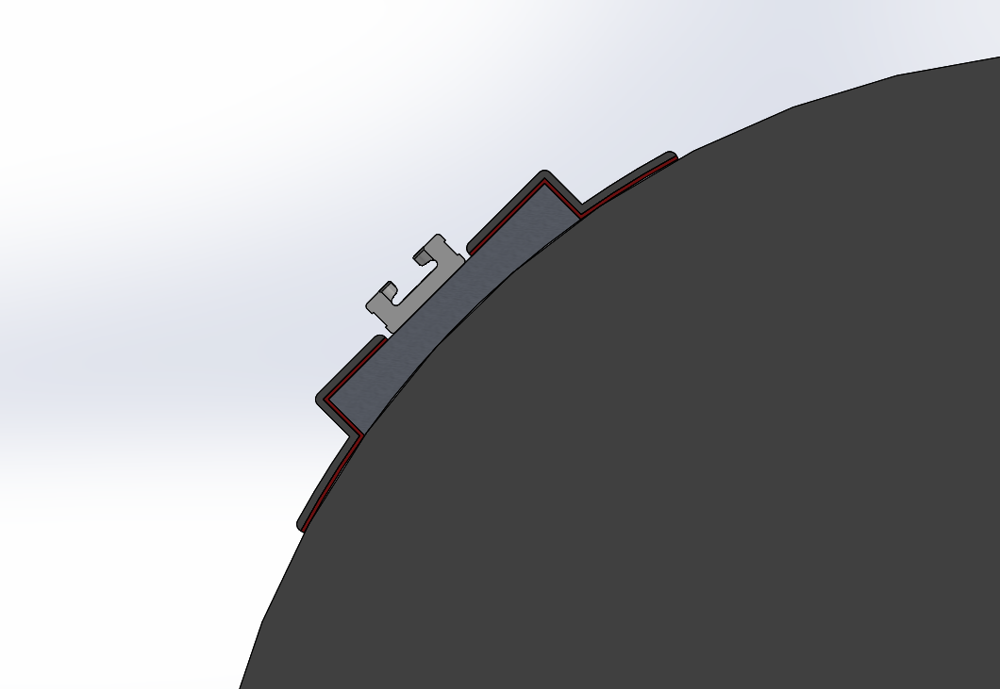
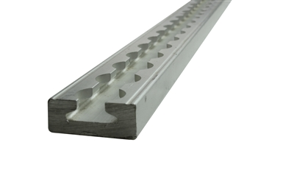
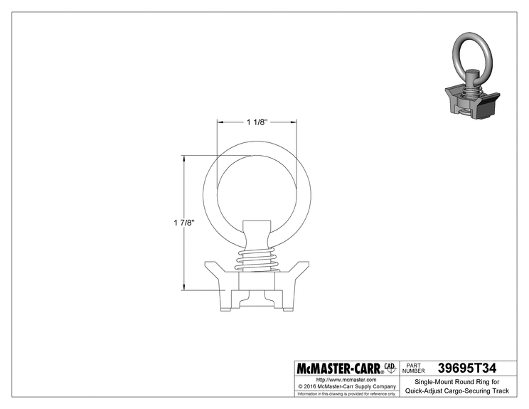
L-track
POLYURITHANE FABRIC COVER
L-TRACK
CHEMICAL BONDING AGENT
(SHOWN IN RED)
Use of L-Track to the Wing Rigid-Hulled Inflatable Boats (RHIBs) allows for easy attachment and removal of seat system
It also allows operators the ability to use COTS accessories such as tie down rings
L-Track mounts to plates that have been chemically bonded to the RHIB, this allows for removal of the L-Track so that the RHIP can be deflated and stored compactly
Future attachment for specialty equipment or weapon mounts could be easily done
ALUMINUM BLOCK
25” INFLATABLE SIDE TUBE

Slide 13
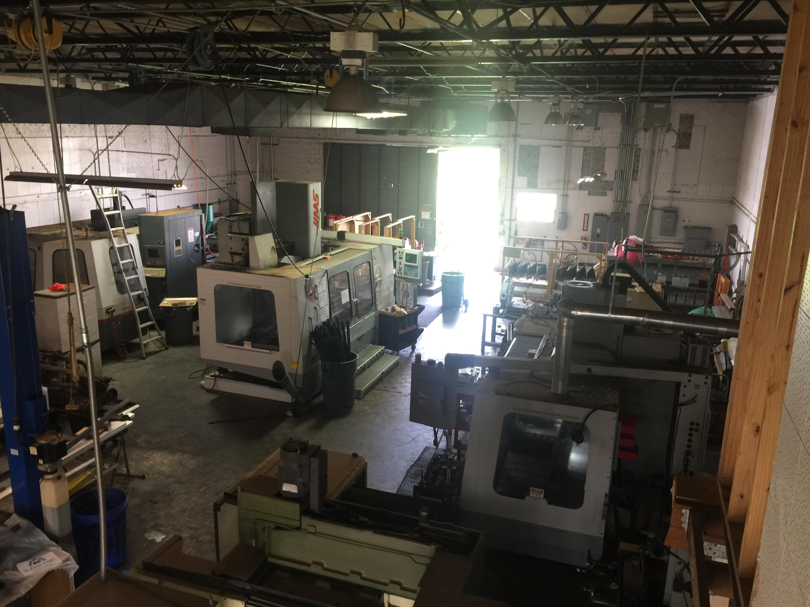
Development plan
Space Coast Unmanned currently has 3500sqft of space available for R&D work
We have a full aerospace quality CNC machining shop and general manufacturing space

Slide 14

Development plan cont.
Space Coast Unmanned would like to work with Wing Inflatable to develop a tested and proven technique to ensure a solid bond of the L-Track
L-Track could be bonded during the Rigid-Hulled Inflatable Boat (RHIB) manufacturing process to ensure repeatable placement and 100% adhesion
Space Coast Unmanned has the resources to test and validate chemical bonding method if Wing Inflatable does not want to invest their time.

Slide 15
COST
With the completion of the conceptual design shown in the previous slides, a prototype could be easily produced at low cost.
With the use of our R&D facility we could keep cost down with out using risky outside suppliers and manufactures.
Space Coast Unmanned would like to move forward with prototype design if given the opportunity.

Slide 16
Space Coast Unmanned’s Solution
Offers a system that includes:
Forward facing ergonomic seats
Seating that is easily reconfigurable, installed and removed
Seat system that operates as a extension ladder up to 10ft
Seat that can be positively buoyant stretcher with a 400lbs person capacity
The use of L-track allows for extra commercial off the shelf accessory's to be used

Slide 17
Resources
This presentation, along with the User Manual and CAD files can be found at our Github repository:
Link here

Slide 18
Contact us
If you have any questions please visit our website at:
https://spacecoastunmanned.com/

